Slide 1

Designed for Real Estate Builders, Developers,
Agents & Brokers.

Slide 2



A SaaS-based Platform Purpose-Built
for Small and Medium Enterprises (SMEs)
The ERP delivery-model of choice for small Real Estate Businesses!
Cost-effective
Easy to use
Insightful dashboards

Slide 3

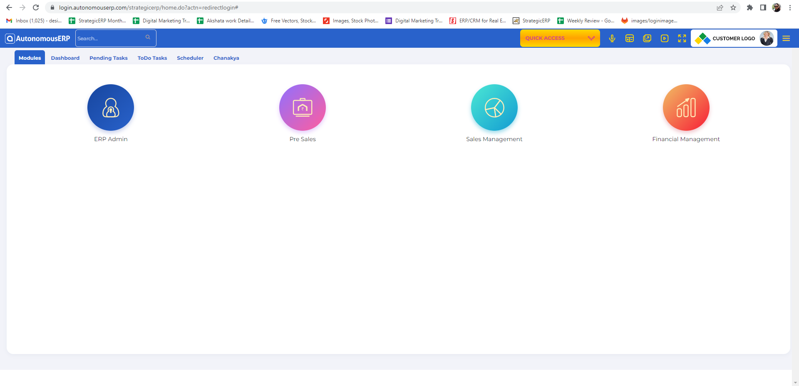
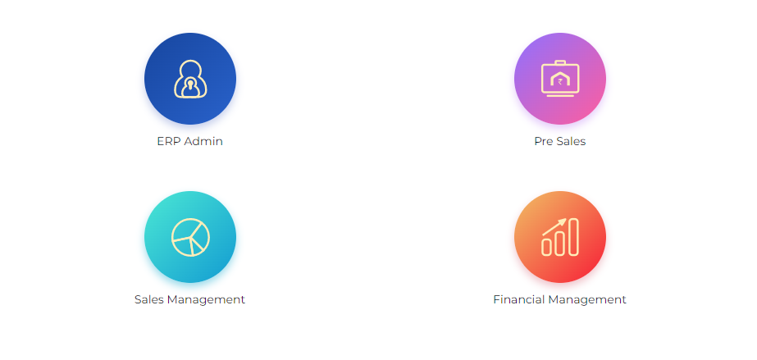
AutonomousERP Modules
Presales & Lead Generation
Sales Automation & Post Sales
Financial Management

Slide 4
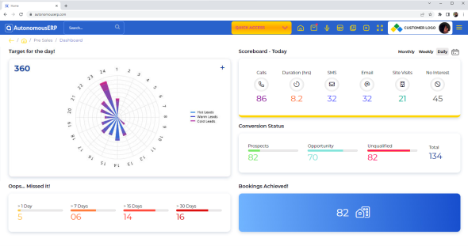
Presales & Lead Generation
Track all pre-sales activities and campaign performance.
Define sales area, basic and floor rise rates
Record project, payment installments and unit details
Graphically view the status of all units
Define additional charges such as maintenance and parking
Track sales person activities
Add channel partners
Assign dialer lists
Manage tele calling source enquiries
Add notes to follow-ups
Monitor stages of prospects and leads
Check unit cost estimations
View daily and performance reports

Slide 5
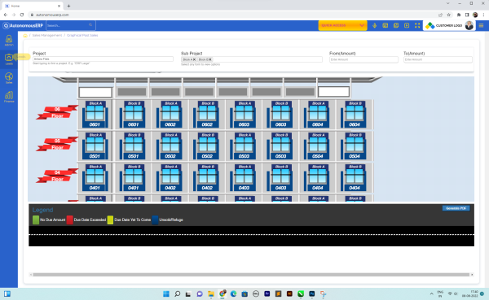
Sales Automation & Post Sales
Manage documentation and nurture customer relationships.
Graphically view all due payments, unit-wise
Track status of work completion
Create informative customer profiles
Update information about new members
Record complete enquiry information
Print installment letters and receipts
Set up follow-up reminders and notes
Allot and track status of car parking
Manage cancellation and transfer of units
Track mortgage details and loan status
Record unit possession information
Check interest on late payments
Prioritize and resolve customer complaints
Generate status reports

Slide 6













Integrations available
Voice commands
Digital media
Biometrics and Face ID
HR voice assistant
IoT integration
Property portals
Chatbots
Task management
Direct calling
Advertising
Productivity Tools
Machinery (Weighbridge)
GPS

Slide 7









Why Choose AutonomousERP?
Budget-friendly
Quicker to deploy
Remote training
Video tutorials
Scalable
AI & ML features
Customer support
Industry expertise

Slide 8




Contact Us
5th floor, D S Business Galleria,
Near Huma Adlabs,
Beside Toyo House,
L.B.S. Road, Kanjur Marg (W),
Mumbai, 400078 INDIA.
+91-7709171035
enquiry@autonomouserp.com
LinkedIn: https://www.linkedin.com/company/autonomouserp/
Facebook: https://www.facebook.com/autonomouserp/
Twitter: https://twitter.com/AutonomousERP
WhatsApp: +91 78938 33648

Slide 9



